Slide 1
CMPE 321
State Diagrams and Registers

Slide 2
State Diagrams
The binary number inside each circle identifies the state the circle represents.
The directed lines are labeled with two binary numbers separated by a slash (/).
The input value that causes the state transition is labeled first.
The number after the slash symbol / gives the value of the output

Slide 3
Design Procedure
The following procedure for the design of sequential circuits is similar to that for combinational circuits but has some additional steps:
1. Specification: Write a specification for the circuit, if not already available.
2. Formulation: Obtain either a state diagram or a state table from the statement of the problem.
3. State Assignment: If only a state diagram is available from step 1, obtain the state table. Assign binary codes to the states in the table.
4. Flip-Flop Input Equation Determination: Select the flip-flop type or types. Derive the flip-flop input equations from the next-state entries in the encoded state table.
5. Output Equation Determination: Derive output equations from the output entries in the state table.
6. Optimization: Optimize the flip-flop input equations and output equations.
7. Technology Mapping: Draw a logic diagram of the circuit using flip-flops, ANDs, ORs, and inverters. Transform the logic diagram to a new diagram using the available flip-flop and gate technology.
8. Verification: Verify the correctness of the final design.

Slide 4
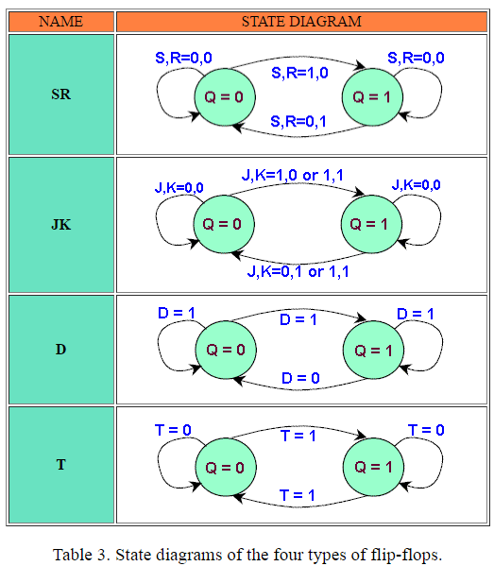
State Diagrams of Flip- flops
From: http://osp.mans.edu.eg/cs212/Seq_circuitst_FF_states.htm

Slide 5
Question 1
Design a sequential circuit with two D flip-flops A and B and one input X. When X 0, the state of the circuit remains the same. When X 1, the circuit goes through the state transitions from 00 to 10 to 11 to 01, back to 00, and then repeats.

Slide 6
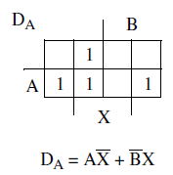
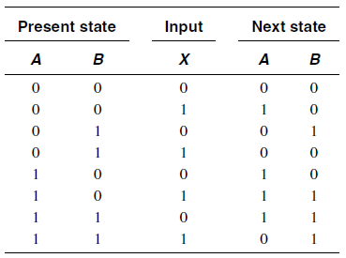
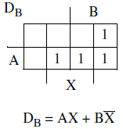
Answer 1

Slide 7
Answer 1
Let us draw the states.

Slide 8
Question 2
A sequential circuit has three D flip-flops A, B, and C, and one input X. The circuit is described by the following input equations:
(a) Derive the state table for the circuit.
(b) Draw two state diagrams, one for X 0 and the other for X 1.

Slide 9
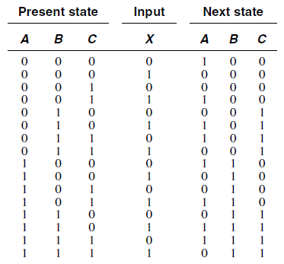
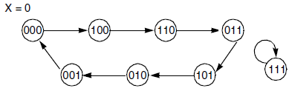
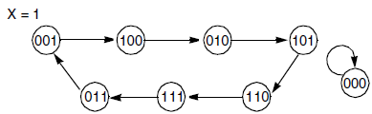
Answer 2

Slide 10
Question 3
A set-dominant master–slave flip-flop has set and reset inputs. It differs from a conventional master-slave SR flip-flop in that, when both S and R are equal to 1, the flip-flop is set.
(a) Obtain the state table of the set-dominant flip-flop.
(b) Find the state diagram for the set-dominant flip-flop.
(c) Design the set-dominant flip-flop by using an SR flip-flop and logic Gates (including inverters).

Slide 11
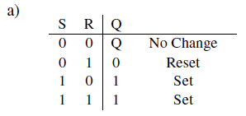
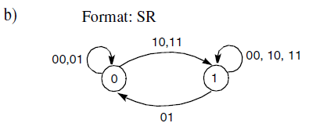
Answer 3: a and b

Slide 12
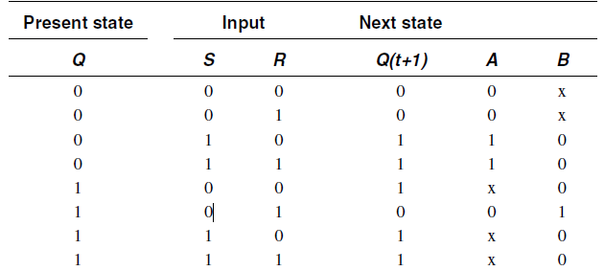
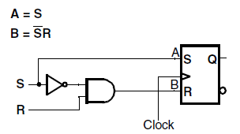
Answer 3: c

Slide 13
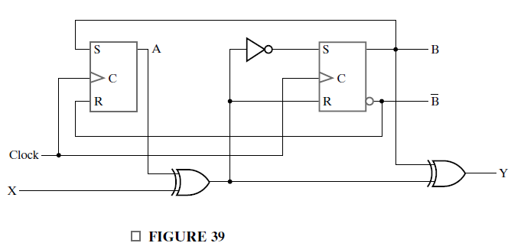
Question 4
A sequential circuit has two SR flip-flops, one input X, and one output Y. The logic diagram of the circuit is shown in Figure 39. Derive the state table and state diagram of the circuit.

Slide 14
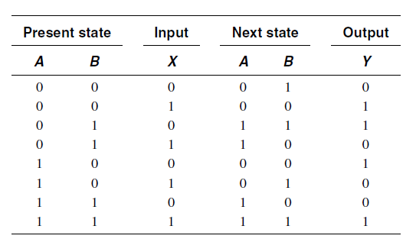

Answer 4

Slide 15
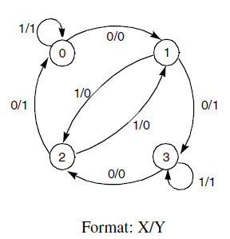
Answer 4: cont.

Slide 16
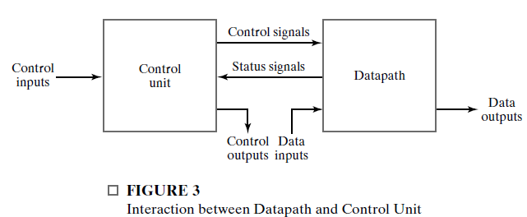
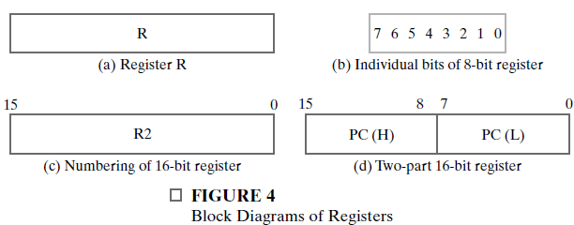
Register Figures

Slide 17
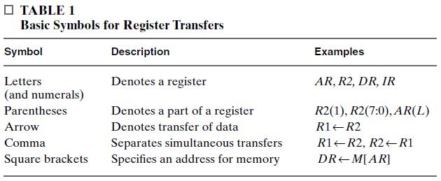
Basics

Slide 18
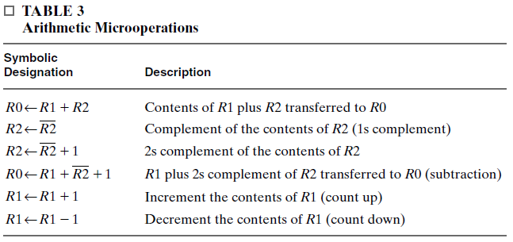
Arithmetic Microoperations

Slide 19
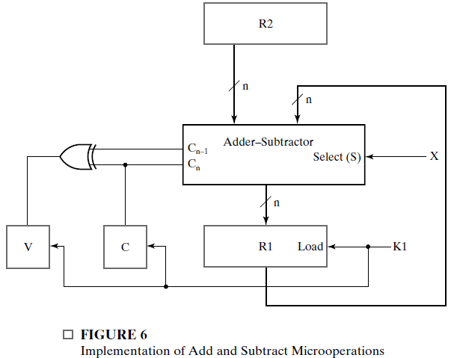

Control variable K1 activates an operation to add or subtract.
If, at the same time, control variable X is equal to 0, then and the contents of R2 are added to the contents of R1.
If X is equal to 1, then XK1 1, and the contents of R2 are subtracted from the contents of R1.
Note that the two control conditions are Boolean functions and reduce to 0 when K1 0, a condition that inhibits the execution of both operations simultaneously.

Slide 20
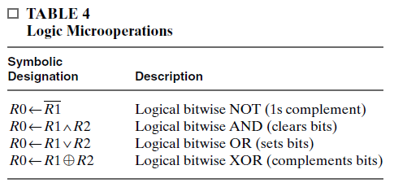
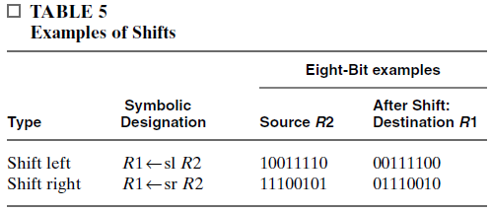
Logic and Shift Microoperations

Slide 21
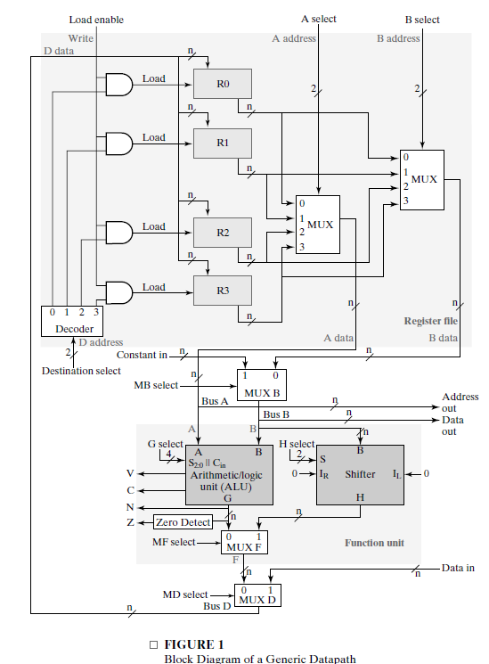
Datapath

Slide 22
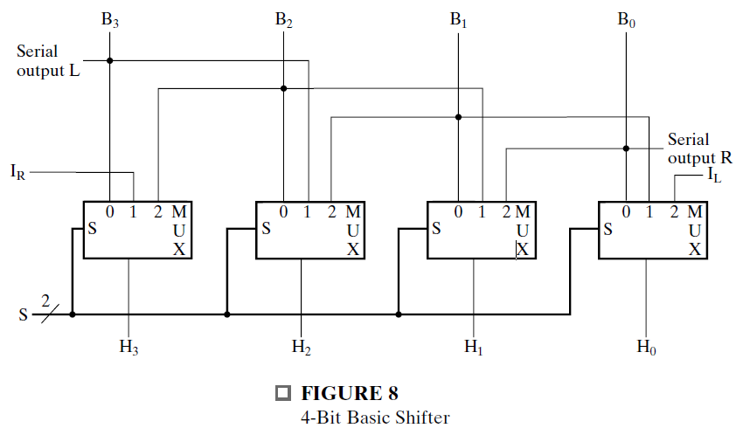
Shifter
The shifter shifts the value on Bus B, placing the result on an input of MUX F.
The basic shifter performs one of two main types of transformations on the data: right shift and left shift.
A seemingly obvious choice for a shifter would be a bidirectional shift register with parallel load. Data from Bus B can be transferred to the register in parallel and then shifted to the right, the left, or not at all.
A clock pulse loads the output of Bus B into the shift register, and a second clock pulse performs the shift.
Finally, a third clock pulse transfers the data from the shift register to the selected destination register.

Slide 23
4-Bit Basic Left/Right Shifter (Figure 10-8)
B
3
B
2
B
1
B
0
Serial Inputs:
I_{R} for right shift
I_{L} for left shift
Serial Outputs
R for right shift (Same as MSB input)
L for left shift (Same as LSB input)
Shift Functions: (S1, S0) = 00 Pass B unchanged 01 Right shift 10 Left shift 11 Unused
Serial
output L
Serial
I
output R
R
I
L
0
1
2
M
0
1
2
M
0
1
2
M
0
1
2
M
S
U
S
U
S
U
S
U
X
X
X
X
S
2
H
3
H
2
H
1
H
0

Slide 24
Barrel Shfter
A barrel shifter is one form of combinational circuit that shifts or rotates the input data bits by the number of bit positions specified by a binary value on a set of selection lines.
The shift we consider here is a rotation to the left, which means that the binary data is shifted to the left, with the bits coming from the most significant part of the register rotated back into the least significant part of the register.

Slide 25
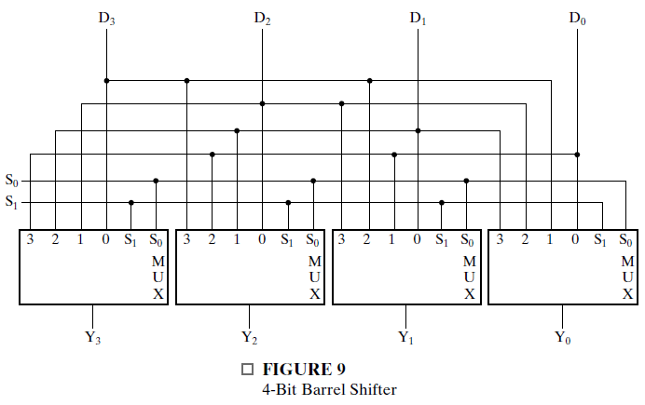
4 bit Barrel Shifter
When S1S0 = 00, no shift occurs, and the input data has a direct path to the outputs.
When S1S0 = 01, the input data is rotated one position, with D0 going to Y1, D1 going to Y2, D2 going to Y3, and D3 going to Y0.
When S1S0 = 10, the input is rotated two positions, and
when S1S0 = 11, the rotation is by three bit positions, causing D0 to go to Y3, D1 to go to Y0, D2 to go to Y1, and D3 to go to Y2.

Slide 26
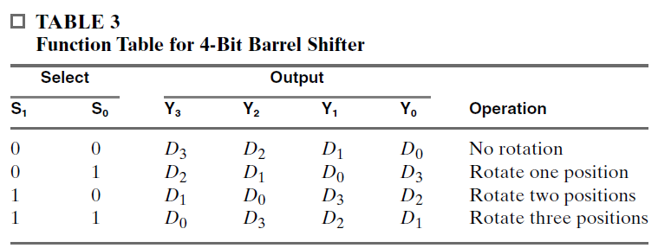
4 Bit Barrel Shifter
In general, in a 2n-bit barrel shifter, i positions of left rotation is the same as 2n i bits of right rotation.

Slide 27
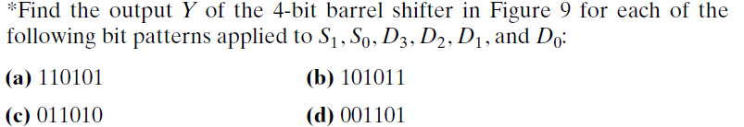
Question 1

Slide 28
Answer 1

Slide 29
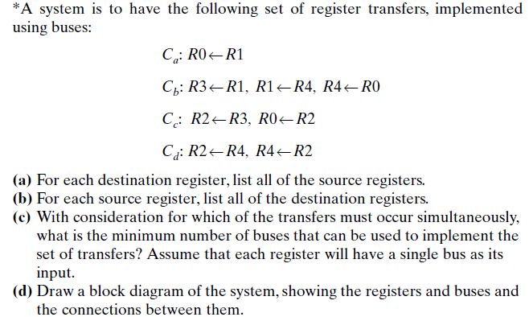
Question 2

Slide 30
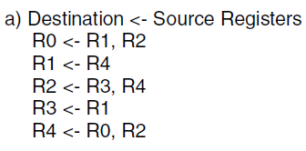
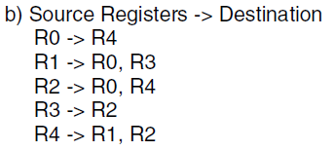
Answer 2 (a,b)

Slide 31
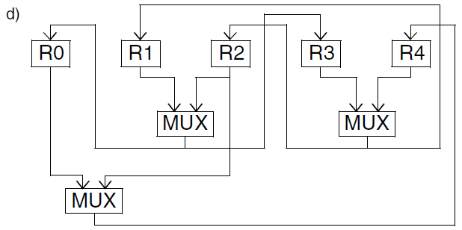
Answer 2 (c,d)

Slide 32
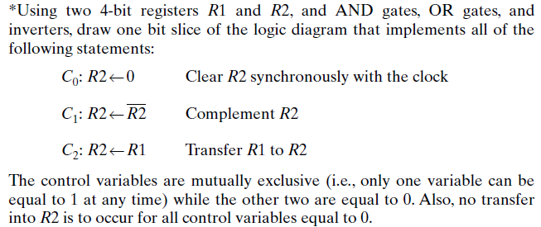
Question 3

Slide 33
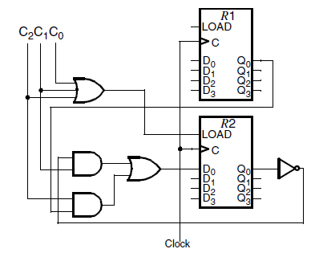
Answer 3

Slide 34
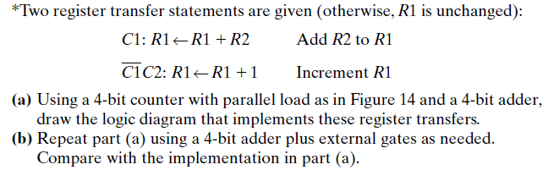
Question 4

Slide 35
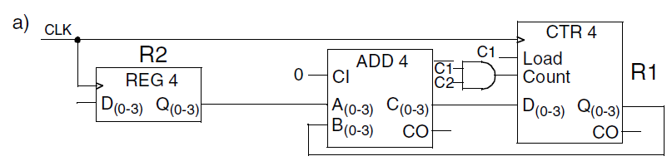
Answer 4(a)

Slide 36
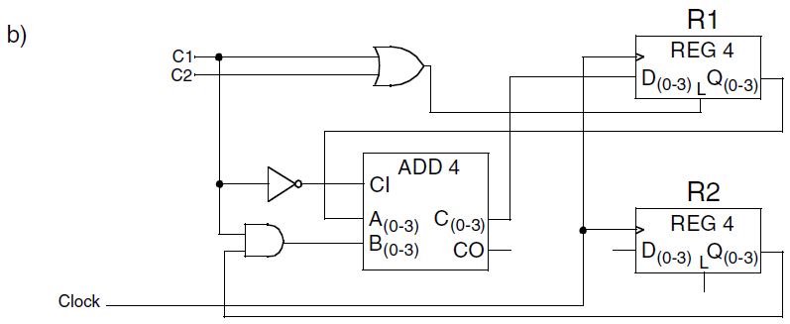
Answer 4(b)

Slide 37
References
http://cas.ee.ic.ac.uk/people/nps/teaching/ee1_digital/Lecture10-State_diagrams.pdf
http://osp.mans.edu.eg/cs212/Seq_circuitst_FF_states.htm
http://www.learnabout-electronics.org/Digital/dig53.php
http://www.electronics-tutorials.ws/sequential/conversion-of-flip-flops.html
http://www.allaboutcircuits.com/technical-articles/flip-flop-conversions-part-ii/
http://www.electronics-tutorials.ws/sequential/seq_4.html

